Slide 1
Reports and Dashboards
LEVEL – PL3
20-07-2023

Slide 2
About the Author
Created By: | Prashant, Sourav Bhattacharya, Supriyo Saha
Credential Information: | Consultant CRM, Sr. Consultant CRM – EAS Salesforce
Version and Date: | V 0.9 :20-July-2023, V1.0: July-2023:Updated with Lightning UI
Modified By: | Sneha Kate

Slide 3
Recap…
In the previous Module - Territory Management, you learnt to:
    Describe VEEVA Data Model – Account Visibility/Territory Alignment
    Explain Territory Hierarchy
    Create Territories
    Explain VEEVA’s Account Territory Loader (ATL)
    Describe ATL Best Practice
    Explain Zip-to-Terr
    Explain Brick-to-Terr
    Describe Territory Fields - Product Alignment by Territory and Account
And now ...

Slide 4

Objectives
After completing this chapter, you will learn to:
  Build reports and dashboards so that you could monitor and analyze your business data
  Explain the difference between a Report, Dashboard and Report Type
  Identify the limitations of VEEVA Reports and Dashboards

Slide 5

Do You Know
Reports are of following types:
  Tabular
  Summary
  Matrix
  Joined
Summary and Matrix reports can be used to generate dashboards.
Report display up to 2000 rows of data
Larger reports can be emailed to Excel
Reports provide two options of exporting data into Excel
Printable View - Export report with formatting into
Excel Export Details - Export raw data

Slide 6
Reports and Dashboards
Introduction On Reports
20-07-2023

Slide 7
Introduction
Reports give you access to your Salesforce data
You can examine your Salesforce data in almost infinite combinations, display it in easy-to-understand formats, and share the resulting insights with others
Before building your report, consider writing down each of the questions your report must answer
This way, your report is sure to return all the data you need
Reports are shared via folders. Whomever has permission to the folder your report is saved in also has access to your report
Ensure that you save your report in an appropriate folder

Slide 8
Reports and Dashboards
Types of Reports Format
20-07-2023

Slide 9
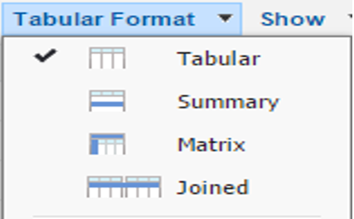
Types of Report Format…1
There are four type of reports:
  Tabular Report
  Summary Report
  Matrix Report
  Joined Reports

Slide 10
Types of Report Format…2
Tabular Report
  Simple listing of data without any subtotals
  This type of report provides you the most basic look at your data
  Use tabular reports when you want a simple list or a list of items with a grand total
Summary Report
  This type of report provides a listing of data with groupings and sub totals
  Use summary reports when you want subtotals based on the value of a particular field or when you want to create a hierarchically grouped report, such as sales organized by year and then by quarter

Slide 11
Types of Report Format…3
Matrix Report
  This type of report allows you to group records both by row and by column
  A comparison of related totals, with totals by both row and column
  Use matrix reports when you want to see data by two different dimensions that aren’t related, such as date and product
Joined Report
  Blocks of related information in a single report
  This type of report enables you to adopt five different blocks to display different types of related data
  Each block can own unique columns, summary fields, formulas, filters and sort order
  Use joined reports to group and show data from multiple report types in different views

Slide 12
Reports and Dashboards
Report Generation
20-07-2023

Slide 13

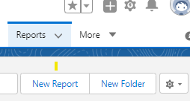
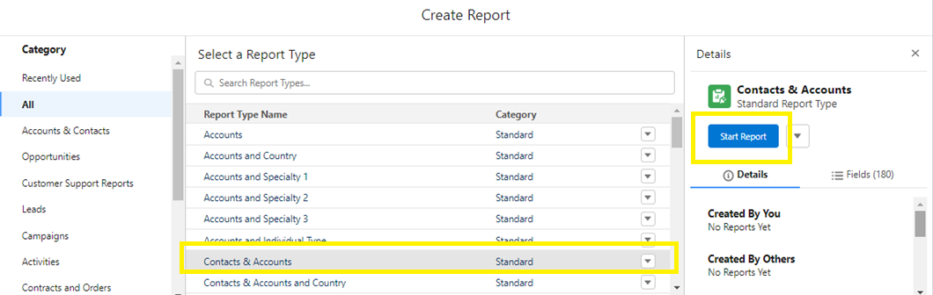
Report Generation…1
Following are the steps for Report Generation:
  Go to Report Tab
  Select New Report
  - Select Report Category and Report type and Click on Start Report

Slide 14
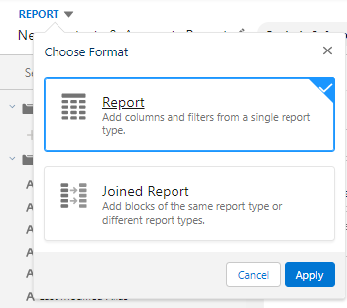
Report Generation…2
  Select Report Format single report type or Joined Report

Slide 15
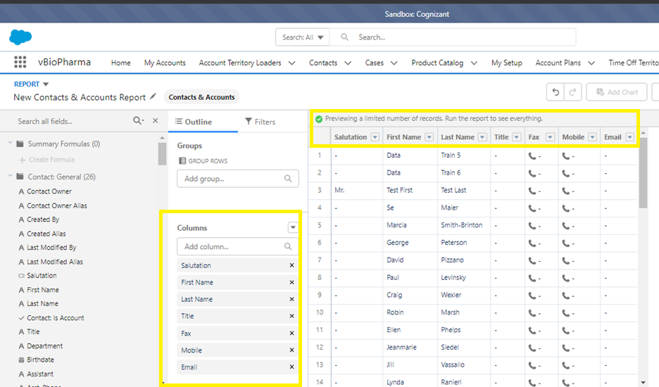
Report Generation…3
  Select Columns to add it in report for example as shown in image First name, Last Name and so on

Slide 16
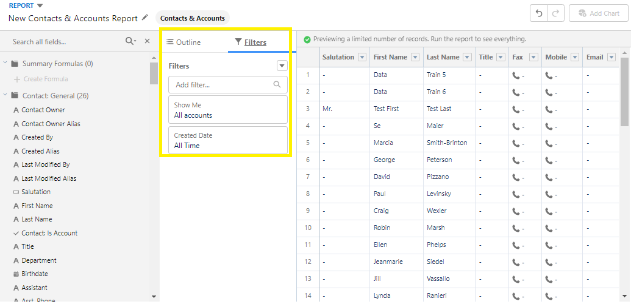
Report Generation…4
  Click on Filters and add Show me as All accounts , Clear Date Range and select as All

Slide 17
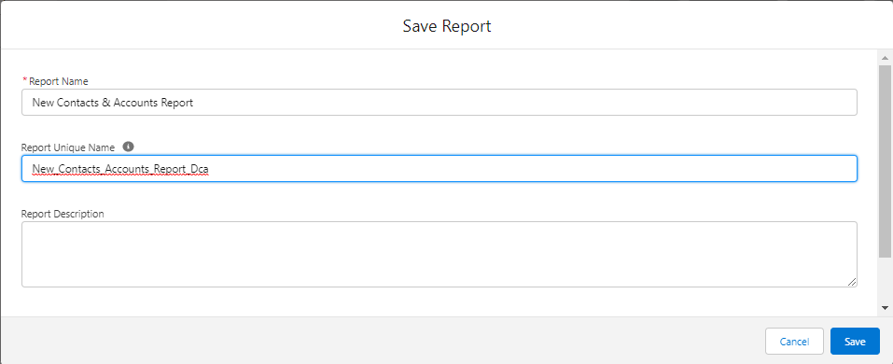
Report Generation…5
  Enter Report name and Report Description

Slide 18
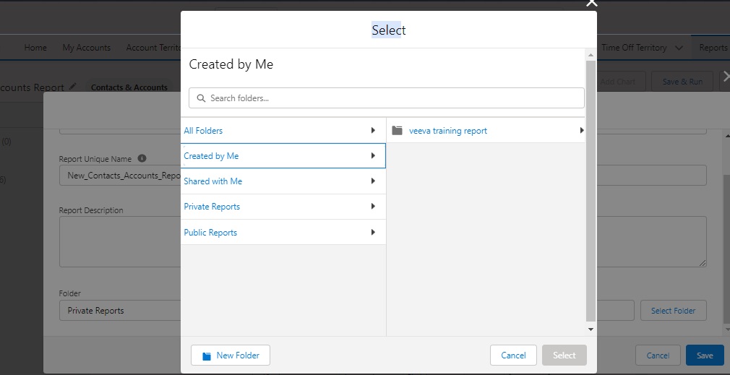
Report Generation…6
  Select Folder to save the Report and Click on Save

Slide 19
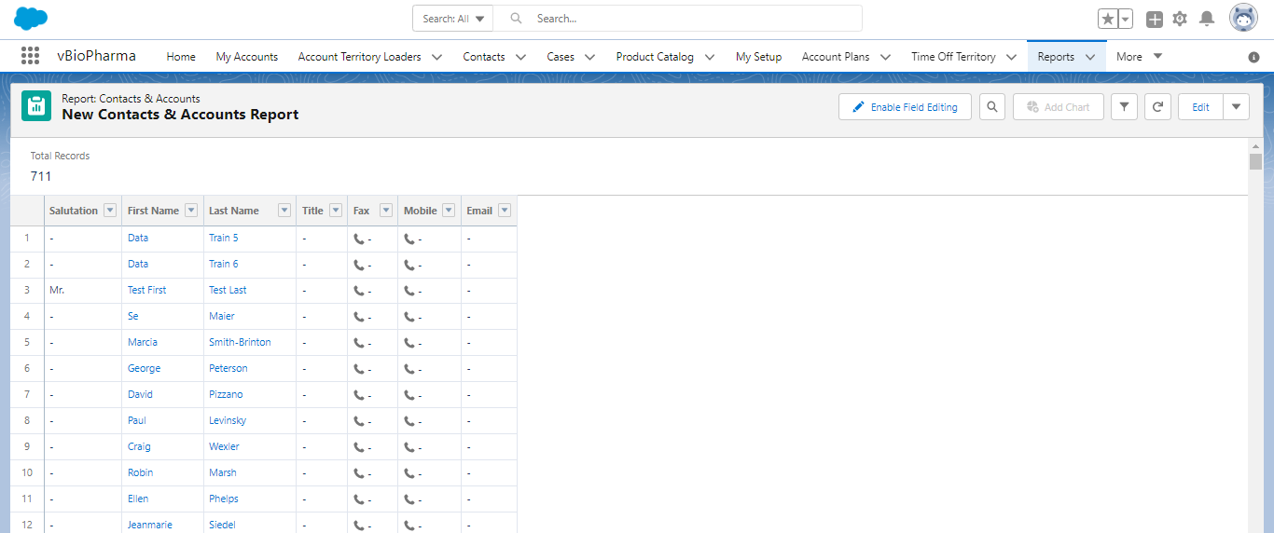
Report Generation…7
  Click on run

Slide 20
Reports and Dashboards
Report Types
20-07-2023

Slide 21
Report Types
There are two type of Reports:
  Standard Report Type
    Created when an object is created
    Created when relationships between objects are created
    Always inner joins
    Cannot be modified
  Custom Report Type
    Created by Admin or users with “Manage Custom Report types”
    Used to streamline the reporting process

Slide 22
Reports and Dashboards
Dashboard
20-07-2023

Slide 23
Dashboard…1
Dashboards help you visually understand changing business conditions so you can make decisions based on the real-time data you have gathered with reports
Use dashboards to help users identify trends, sort out quantities, and measure the impact of their activities
A dashboard can have up to 20 components

Slide 24
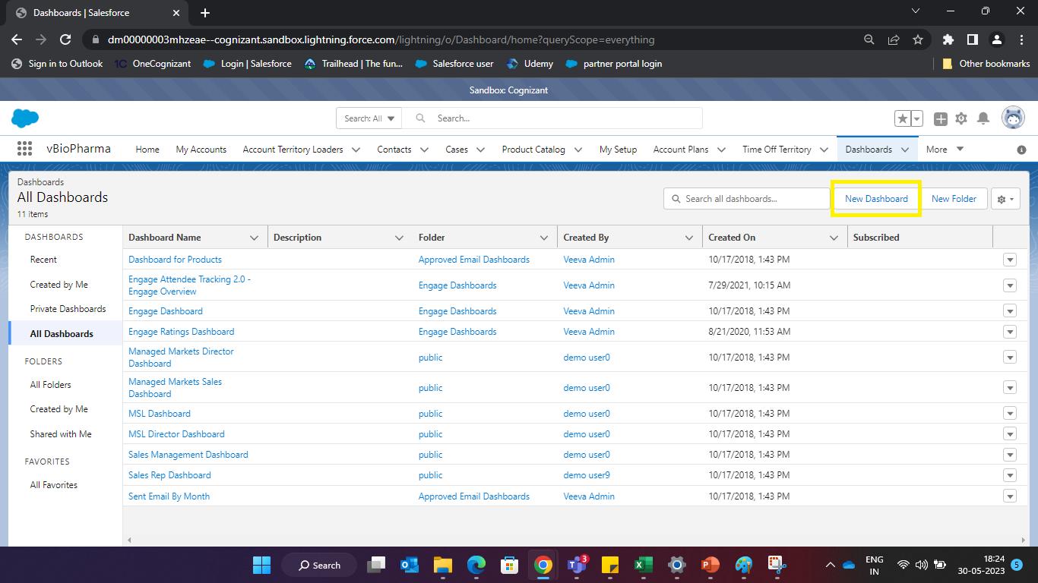
Dashboard…1

Slide 25
Dashboard…2
The folder in which dashboards are stored determines which user has access to running the dashboard
The dashboard data is based upon the reports data
When a user views the drill-down report for a dashboard component. running user's access permissions determine what data is displayed on the drilldown report
Hence it is possible that the data in the drill down report does not match the cumulative dashboard data
Dashboard also support automatic refresh and email. The refresh and email can also be scheduled at intervals - daily, weekly, monthly
Two things that determine access to dashboards:
  Dashboard Folder
  Running User

Slide 26
Dashboard Types
There are five type of dashboards:
  Chart: Used for comparisons
  Table: Good for showing top five, bottom five lists
  Gauge: Used to show progress towards a goal
  Metric: Shows a single number
  Visual Force page: used to pull data from other sources

Slide 27
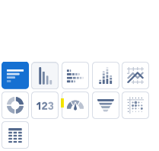
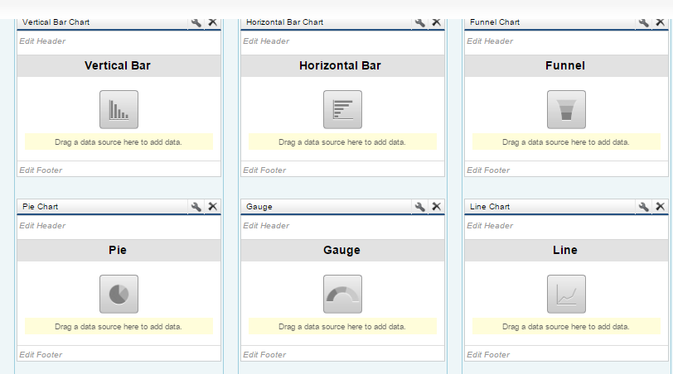
Dashboard Chart Type
  There are six types of Dashboard Chart in VEEVA CRM:
    Vertical column
    Horizontal bar
    Line
    Donut
    Funnel
    Pie

Slide 28
Reports and Dashboards
Limitations of VEEVA Reports and Dashboards
20-07-2023

Slide 29
Limitations of Veeva Reports and Dashboards
You can create a dashboard only from the matrix and summary reports
A maximum of 2,000 rows will be displayed in a report. To view all the rows, export the report to Excel, or use the printable view for tabular and summary reports. For joined reports, the export option is not available, and the printable view displays a maximum of 20,000 rows
In the report builder, up to 20 rows will be displayed for summary and matrix reports and up to 50 rows for will be displayed in the tabular report
By default, reports time out after 10 minutes. You can contact Salesforce.com support to extend the time-out limit to 20 minutes for tabular, summary, and matrix reports, but no extension is available for joined reports. It will continue to time out after 10 minutes
You must wait at least one minute between dashboard refreshes

Slide 30
Best Practice - Reports and Dashboards
Know Your Audience
Folder permissions plays key role
Manage Report Types
Controlling Access to Reports and Dashboards
Reports and Dashboards Resources for Sales Leaders and Executives

Slide 31
Check Your Understanding ... 1
1. What type of report cannot be used to populate a chart in a dashboard?
Summary
Matrix
Tabular
Answer: Tabular

Slide 32
Check Your Understanding ... 2
2. Which report type allows you to group the report results and then summarize information about those groupings?
Tabular Report
Summary Report
Joined Report
Answer: Summary Report

Slide 33
Check Your Understanding ... 3
3. Dashboards automatically refresh every time you open them.
State True or False
True
False
Answer: True

Slide 34
Check Your Understanding ... 4
4. You can use standard reports when creating Dashboards.
State True or False
True
False
Answer: False

Slide 35
Check Your Understanding ... 5
4. What is the maximum number of Components available on a Dashboard?
20
10
5
50
Answer: 20

Slide 36

Summary
In this module, you have learnt to:
  Build reports and dashboards so that you could monitor and analyze your business data
  Explain the difference between a Report, Dashboard and Report Type
  Identify the limitations of VEEVA Reports and Dashboards

Slide 37
Source
https://trailhead.salesforce.com/en/modules/reports_dashboards/units/reports_dashboards_overview
Disclaimer: Parts of the content of this course is based on the materials available from the Web sites and books listed above. The materials that can be accessed from linked sites are not maintained by Cognizant Academy and we are not responsible for the contents thereof. All trademarks, service marks, and trade names in this course are the marks of the respective owner(s).

Slide 38
Coming Next ...
In the upcoming module - iRep Configuration Basics, you will learn to:
  Describe iRep
  Install iRep
  Navigate iRep UI
  Configure iRep
  Describe CLM
  Configure CLM

Slide 39
Thank you
  You have successfully completed
  Reports and Dashboards Course

